Slide 1
Introduction to AI & Data Science: Data Wrangling,Visualization and EDA
Adarsh Ghimire

Slide 2
Introduction
Artificial Intelligence (AI)
Simulation of human intelligence by machines—includes learning, reasoning, and self-correction.
Machine Learning (ML)
A subset of AI where systems learn from data to improve performance without being explicitly programmed.
Deep Learning (DL)
A subset of ML using neural networks with many layers to model complex patterns in data.
Data Science (DS)
An interdisciplinary field combining statistics, programming, and domain knowledge to extract insights from data.
Big Data
Extremely large datasets—high in volume, velocity, and variety—that traditional tools can't handle efficiently.

Slide 3
Applications of AI & Data Science
AI & DS are transforming various industries with automation, predictions, and insights:
Healthcare: Predictive diagnostics, drug discovery, personalized treatment, medical imaging.
Finance: Fraud detection, risk assessment, algorithmic trading, credit scoring.
Marketing: Customer segmentation, recommendation systems, sentiment analysis.
Education: Personalized learning, automated grading, virtual tutors, student performance prediction.

Slide 4
Data Wrangling
Data wrangling, also known as data munging or data remediation, involves cleaning, transforming, and preparing raw data into a format suitable for analysis.
It is done:
Ensure data quality and consistency.
Transform data into a usable format.
Handle missing values, outliers, and inconsistencies.
Integrate data from multiple sources.
There are normally six steps in wrangling process:
Discovery - Understand and explore the data
Structuring - Organize data into a usable shape
Cleaning - Fix or remove incorrect, missing, or duplicate data
Enriching - Add or enhance data using external sources
Validation - Check for accuracy and quality
Publishing - Make final data available for use

Slide 5
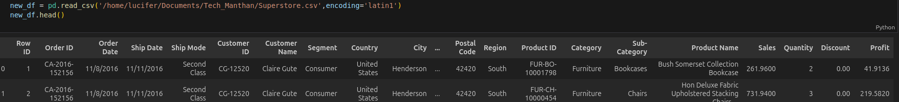


Data Wrangling on Superstore Dataset

Slide 6
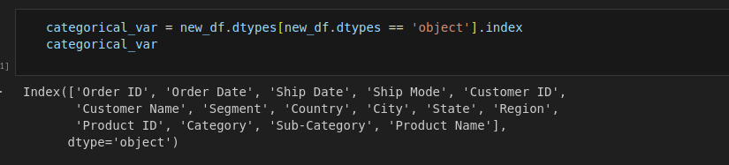
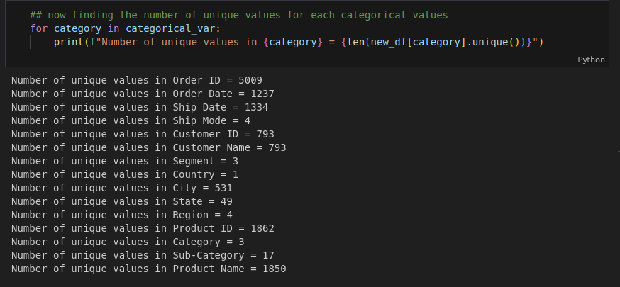

Slide 7


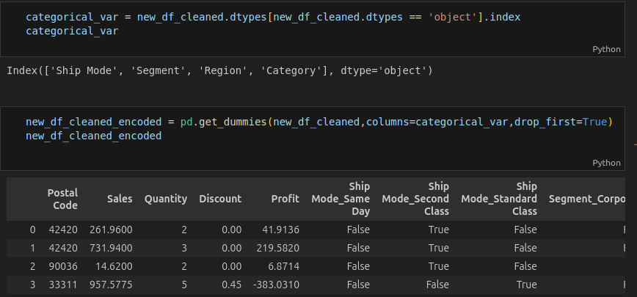
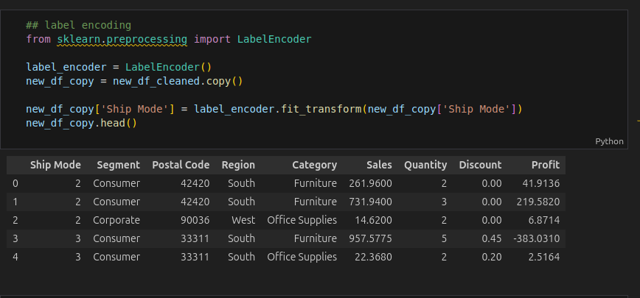
- Dropped high-cardinality columns
- Dropped ‘Country’ (only USA)
- Applied one-hot and label encoding
Applying one-hot encoding and label encoding:

Slide 8
Visualization with Matplotlib
Matplotlib is a Python library for creating static, animated, and interactive plots.
Common type of plots:
Line plots
Bar charts
Scatter plots
Histograms
It is used to:
Understand data patterns
Detect patterns and outliers
Communicate results clearly

Slide 9
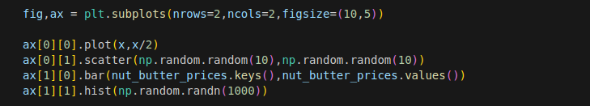
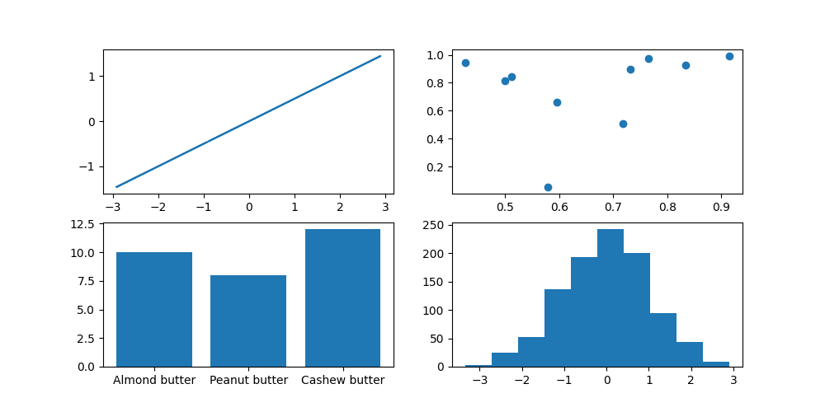
Visualization Example:

Slide 10
Exploratory Data Analysis:
EDA helps understand data before modeling.
It involves:
Summarizing features
Finding patterns
Detecting anomalies
Visualizing distributions
Common Tools:
describe(), info()
various type of plots like univariate , bivariate ,etc.

Slide 11
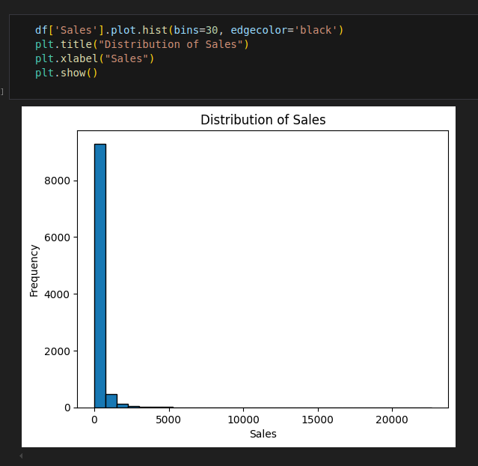
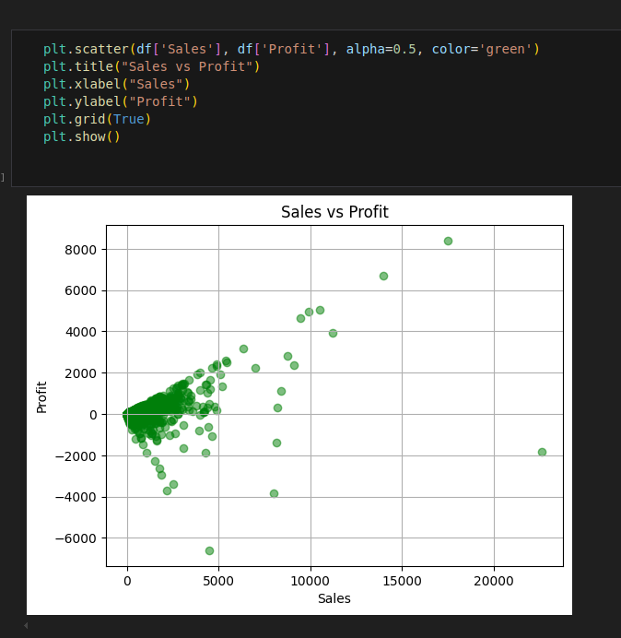
Univariate Plot
Bivariate Plot

Slide 12
Skewness
Skewness measures asymmetry of data distributions.
Left-Skewed: Long tail on left.
Right-Skewed: Long tail on right.
Transformations: Log, Square root

Slide 13
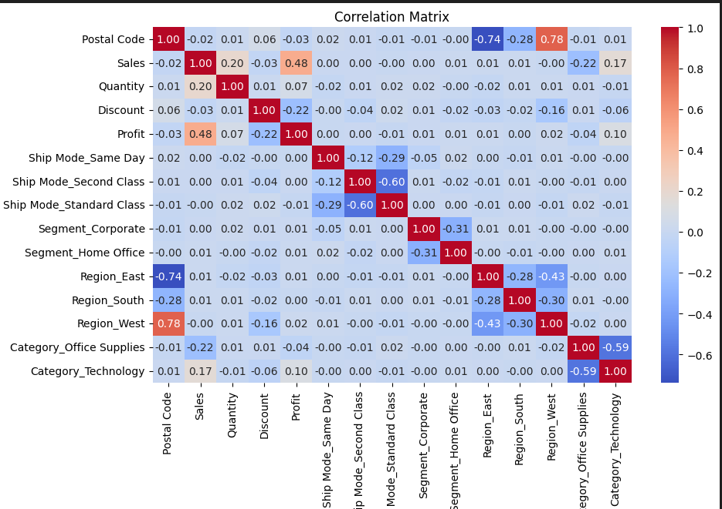
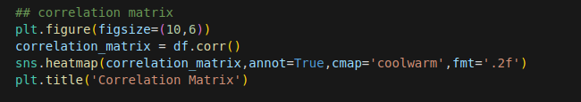
Correlations
Correlations measures the strength and direction of a relationship between two variables.
Types of Correlation:
Positive: Both variables increases together
Negative: One increases, the other decreases
Zero: No relationship

Slide 14
Outliers Detection & Treatment
Outliers are unusual values that differ significantly from other data points.
Detection Methods:
Box Plot - Visualize outliers beyond whiskers
Z-score - Values with |z| > 3
IQR Method:
Treatment Options:
Remove - If it’s an error or irrelevant
Cap/Floor - Replace with nearest valid value
Transform - Use log or square root
Impute - Replace with mean or median
etc.

Slide 15
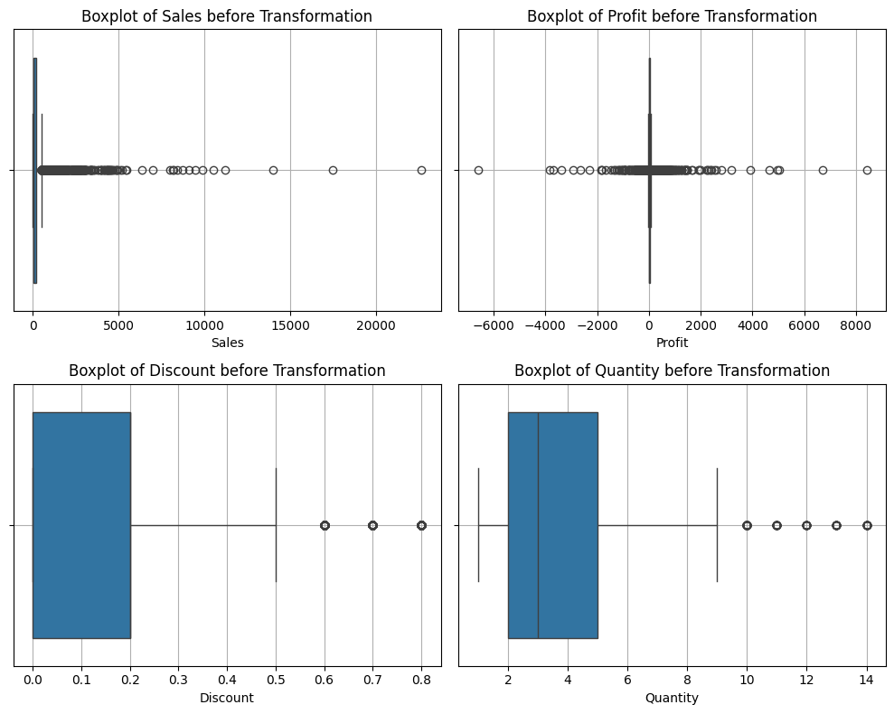
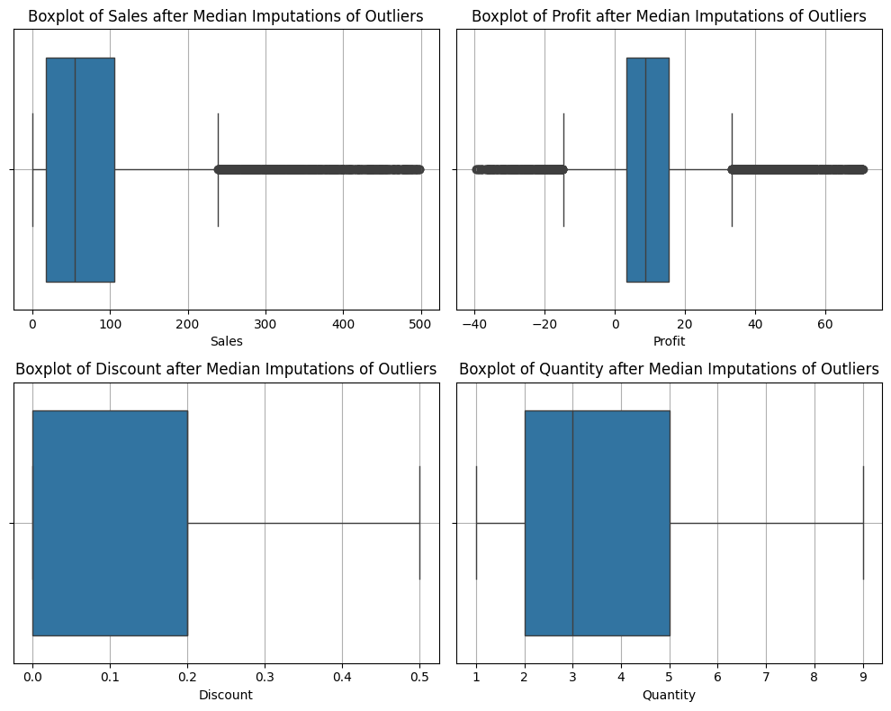
Before Transformation
After Transformation

Slide 16
Thank You

